Slide 1


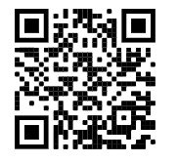
Python Crash Course
Led by Paul Kaefer
Plymouth Library
2022-12-10
course files: bit.ly/2022_crash_course

Slide 2

Welcome!
Let’s start with some introductions…
Name
Current occupation or student/field of study
What is your interest in this “crash course”?
Do you have any programming experience?
Last book you read for fun?
Image courtesy of Wikimedia Commons (https://w.wiki/5ogW)

Slide 3
Quick poll: what OS(es) are you using?
Windows?
Mac?
Chromebook?
Other… (Linux, tablet, etc.)

Slide 4
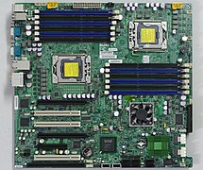
Computers don’t think like us!
Helpful to think about when you learn programming.
You have to tell a computer exactly what you want it to do & it will follow your instructions exactly.
Although it is logical, it won’t apply human logic, unless you teach it how.
Image courtesy of Wikimedia Commons (https://w.wiki/5ogX)

Slide 5
Many, many programming languages!
Python is not the only programming language out there, but it is one of the most popular.
Python is general-purpose and interpreted.
General-purpose means it can be used for many things: websites, app development, data analytics, machine learning, image processing, and more!
Interpreted means that Python reads each line in order and executes them.*
*there are also ways to compile Python code, but that’s not a focus today

Slide 6
Let’s write our first line of code!
Windows: Command Prompt
Either search in Start Menu, or Windows + R and type “cmd” and hit enter
Mac: Terminal
Command + Space: type “terminal” and hit enter
Chromebook (bit.ly/PythonChromebook)
Open terminal (via search key or app launcher)
If you have another system, let me know!

Slide 7
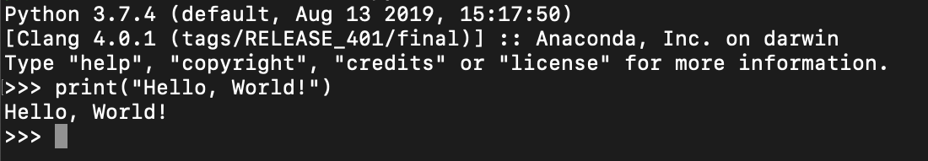
Executing code in the terminal:
Type print(“Hello, World!”) and hit enter
*** Code examples will be in Courier New font ***
Your view may be a little different, but should show the message on the line below where you typed:

Slide 8
Calculations using variables!
Variables are how we can save values for later.
To assign a value to a variable:
variable_name = value
For example:
x = 3
You can then use x in calculations like:
x * 16

Slide 9
More about variables
Variables are fundamental in programming, and can store much more than just numbers.
Let’s try a few examples. First assign the values below:
my_name = “Paul”
favorite_numbers = [3.14, 7]
Now try accessing them:
print(“My name is ” + my_name)
print(favorite_numbers[0])
Which value was printed out?

Slide 10
Accepting User Input
One way that we can write programs that can do different things is to accept user input.
Try this:
number = input(“What is your favorite number?”)
print(“Your favorite number is ” + number)
What other uses might we have for user input?

Slide 11
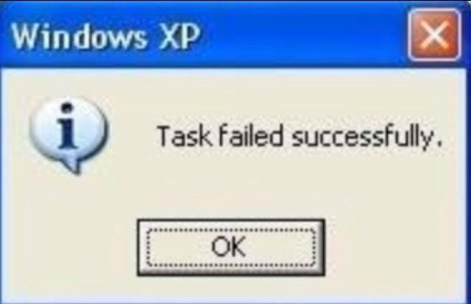
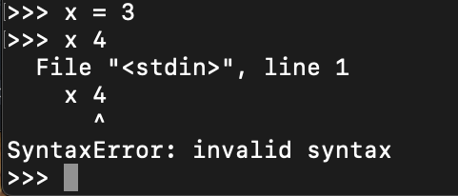
Errors!
Errors happen to everyone who writes code.
Although they might look scary, they are always trying to convey helpful information.
There are three types: syntax errors, exceptions, and logic errors
Did you mean to do x + 4?
x * 4?
Or something else?

Slide 12
Errors, part 2
Exceptions happen when you try to do something that is not allowed or not defined.
Try
Print(“Testing!”)
(remember, earlier we used print with lowercase ‘p’)
Or:
“1” + 2

Slide 13
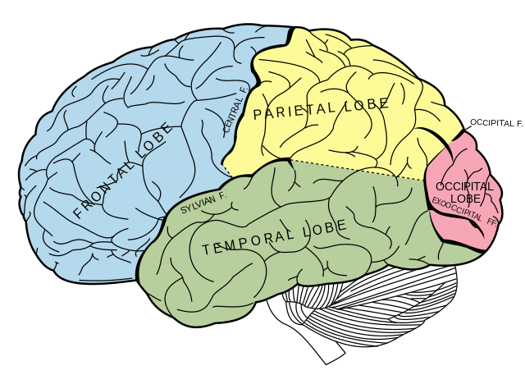
Logic errors
Logic errors are the often the most difficult to identify. For example, this code will not result in any errors:
a = 20
b = 40
average = a + b / 2
print(average)
What value gets printed? Can you find the logic error?
Image courtesy of Wikimedia Commons (https://w.wiki/5opx)

Slide 14

Using Jupyter Notebooks
Most of the time, we don’t write and execute code line-by-line
Jupyter Notebooks provide a great way to interactively run code – and save it
Try running jupyter-lab
…or jupyter lab
If that doesn’t work:
jupyter.org/install for Mac/Windows/Linux
codecademy.com/article/jupyter-notebook-chromebook for Chromebooks

Slide 15
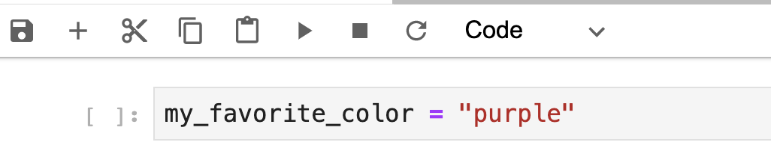
Conditional logic
A very important part of programming is writing code that will make decisions.
In your notebook, create a variable with your favorite color. For example:
Next, click the ▶️ button to run that cell

Slide 16
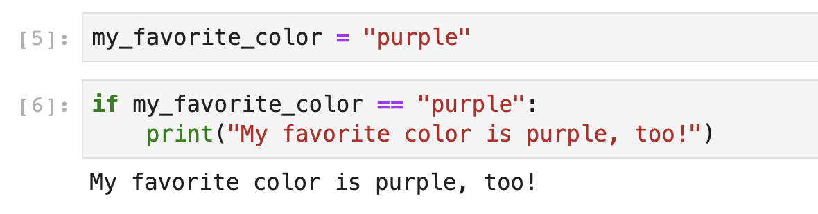
Writing an IF statement
In the next cell, let’s write our first IF statement. This will make a comparison that is either True or False
Try changing the value of the variable in the first cell, or the value in the IF statement. What happens?

Slide 17
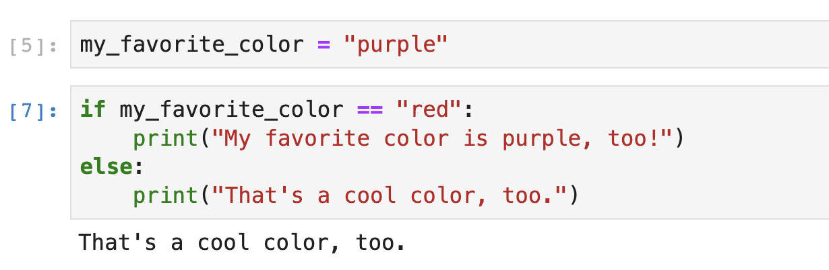
IF + ELSE
Now let’s add an ELSE statement after the IF. This will execute whenever the logic in the IF statement returns a value of FALSE:

Slide 18
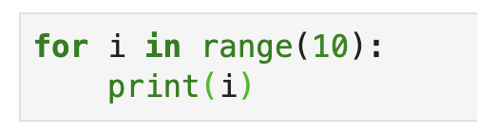
Simple loop
The next concept is a loop. Loops will run the same code over and over a specific number of times. This process is also called iteration. Try this example:
What values were printed out? Can you explain why?

Slide 19
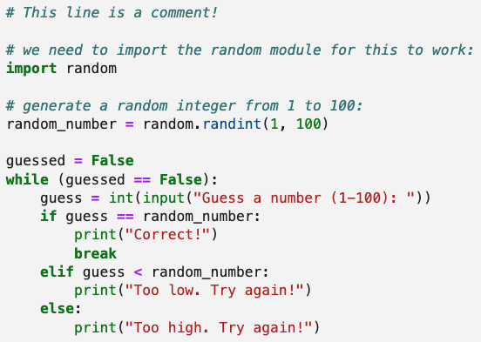
Simple guessing game code
course files: bit.ly/2022_crash_course
Open the guessing_game.ipynb file (or type the code below). Try running it. Can you explain what each line is doing?

Slide 20
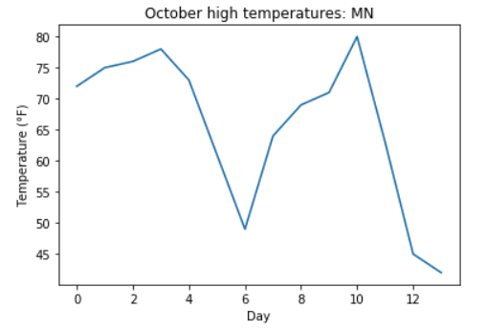
Simple graphs
course files: bit.ly/2022_crash_course
In your terminal, you will want to do
pip install matplotlib
Open the simple_temperature_graph.ipynb file in Jupyter Lab and execute it. You should get a graph:

Slide 21
Running code file
course files: bit.ly/2022_crash_course
We demonstrated using the command-line interpreter to run Python code
We also used Jupyter Notebooks to run code interactively
Another option is to execute a Python code file (ends in .py).
Navigate to the folder where you have the files from today’s session downloaded
Try running python taxi_fare.py from your terminal
This is a sample file from my book!

Slide 22
Advanced challenges
Write a program that will allow a user to enter three different values. Then have the program print the average.
The Fibonacci sequence starts 0, 1, 1, 2, 3, 5, 8, … where each successive value is the sum of the two values before it. Write code that will output the first n numbers in this sequence.
Try starting a simple game that prints text and asks the user to make decisions!

Slide 23
Ways to Develop Code
You can use any text editor (Sublime, notepad.exe or Notepad++ on Windows, gedit on Mac or Linux, etc.)
You can use Jupyter Notebooks, like we explored
These are popular with scientists/researchers, and are great for learning and seeing exactly what is happening with each line or section of code
You can use an Integrated Development Environment (IDE), which is essentially a program that helps you write and format code
IDLE often comes installed with Python
VS Code is popular
Two that I use at work: PyCharm and Spyder
…if you’re really nerdy, you can even edit code using vim!

Slide 24
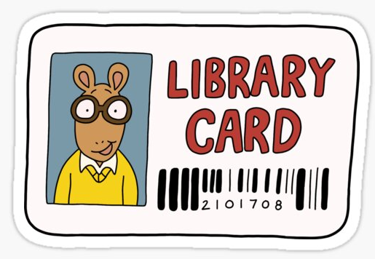
Resources at the Library
Many books! Some that I recommend:
Introduction to Python Programming for Business and Social Science Applications, by Frederick and Paul Kaefer
Online resources, including example data and code files: bit.ly/KaeferPythonResources
Learn Python 3 the Hard Way, by Zed Shaw
This is the book I used to teach myself Python!
Think Python, by Allen Downey
Also available for free at greenteapress.com/wp/think-python
Some are listed as “Children’s” books – but that could mean the language used to explain concepts is less intimidating than textbooks!
Teach Your Kids to Code, by Bryson Payne
Python for Kids, by Jason Briggs

Slide 25
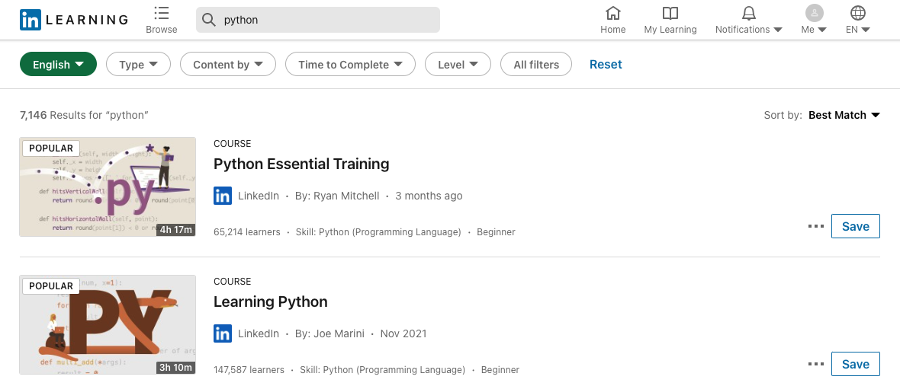
…and more resources!
LinkedIn Learning (formerly Lynda.com) is available for free.
Visit hclib.org/programs/computers-technology to learn more.
I found 7,146 results for “python” and 659 for “computer programming”
You can search specific categories like “python for data science”

Slide 26
More advanced books
I really like Hands-On Machine Learning with Scikit-Learn and TensorFlow, by Aurélien Géron
Definitely a more advanced title, as it assumes some Python experience and it’s helpful to have an introductory stats understanding.

Slide 27
Other resources (not library-specific)
HackerRank is a site where you can practice coding skills and prepare for coding interviews. hackerrank.com
Project Euler is a great site with challenging problems. See projecteuler.net
Reddit is a great place to ask questions and find resources. Two great communities are reddit.com/r/learnprogramming and reddit.com/r/Python
Rosetta Code is a neat site that shows solutions to various programming problems. See rosettacode.org/wiki/Rosetta_Code
Stack Overflow is a great place to ask (and answer) questions. See stackoverflow.blog/2021/07/14/getting-started-with-python/ for a great blog post they did about Python.

